Slide 1
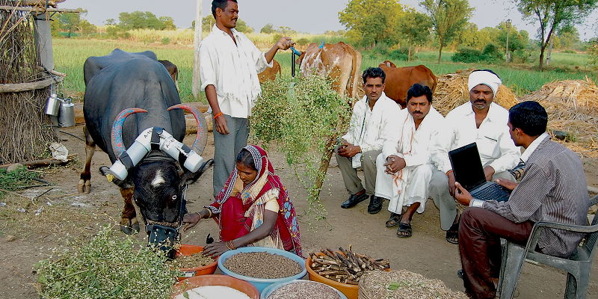
DAIRY FARM MANAGEMENT
Mr.NEERAJ KUMAR
Mr.VIKASH KUMAR
Mr.BANSHI LAL
Mr.MAHIPAL JAT

Slide 2
Quality and Quantity of Milk
Entrepreneur
Income
Farmer
How to Enhance Milk Production?

Slide 3
CHALLENGES FACED BY FARMERS
Inadequate Feeding of Animals
More Disease Incidence
Lack of Information
Improper Cattle Management

Slide 4
DAIRY APPLICATION
Farmer Cattle Registration
Company Registration
Phone Number
Company Name
Cattle Type
Breed
Product Name
Age
Contact No.
Milk Production
Fat Content in Milk
Email Id
Submit
Submit

Slide 5
Business Model
Animal Nutrition
Feeding Schedule
Animal Health
Vaccination
Animal Management
Ration Formula
Deworming
Disease Screening
Reproductive Efficiency
Selection Of Breed
Training
Company List
Company Name
Rate
Contact Number
Doctor Consultancy
Name of Doctor
Name of Medical Store
Expert Consultancy
Expert name
Contact Number
Milk Collection Point
Hotels List
Name Of Hotel
Requirement of milk
Contact
Name of milk value
added company

Slide 6
Company Paid
Registration Charge:500/-
No. of Cases Deal:100/-
Doctor Consultancy
Registration:500/-
Vaccination:100/-
No. of Cases Visited:100/-
Disease Screening:100/-
Reproductive Efficiency:100/-

Slide 7
Expert Suggestion
Selection of breed:100/-
Training:00/-
KVKs, NABARD & Others
Milk Collection Point
Local Level
Hotels Registration Charge:500/-
Sweet Shop Registration Charge:500/-
Company Level

Slide 8
Advertisement Income
Registration Charge :500/=
One Month Charge :2000/=

Slide 9
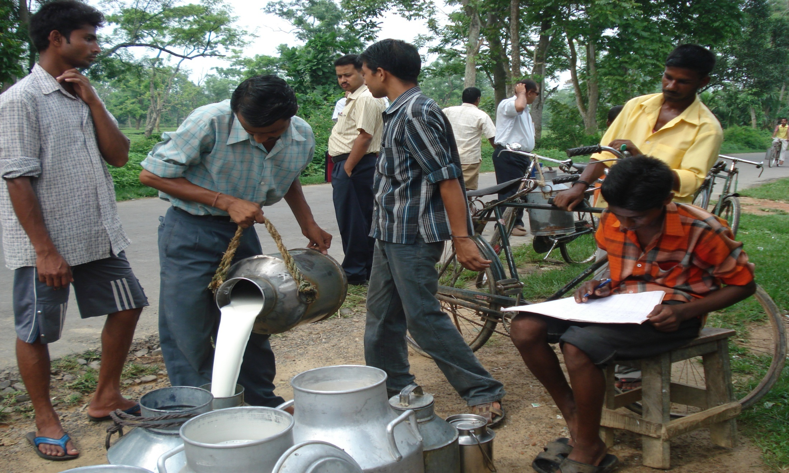
Thanks!

